Slide 1
Graph and Its Applications

Slide 2
Graph and Their Applications
Graph
Nonlinear data Structures.
A graph G consists of two properties:
(a) A set V of elements called vertices or nodes.
(b) A set E of connectors called edges such that each edge e is identified as
e = [u,v] (unordered pair of vertices). Here u and v are called endpoints of
e and they are said to be the adjacent nodes or neighbors .
The order of a graph is |V| (the number of vertices).
A graph's size is |E|, the number of edges.
A tree is a graph with no cycle.
Example:
A
B
In Graph G₁
5 Vertices:{A, B, C, D, E}
6 Edges: {[A,B], [A,C], [B,D],
[B,E], [C,D], [D,E]}
E
C
D
Figure1: A graph G₁

Slide 3
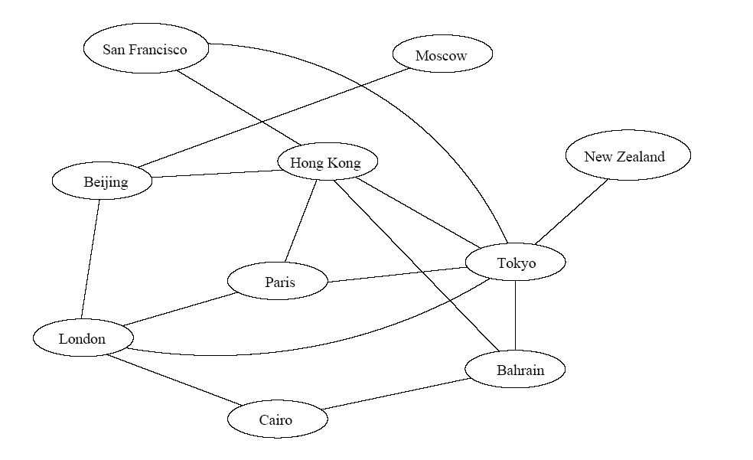
Application
Air flight system
Each vertex represents a city
Each edge represents a direct flight between two cities
A query on direct flights = a query on whether an edge exists
A query on how to get to a location = does a path exist from A to B
We can even associate costs to edges (weighted graphs), then ask “what is the cheapest path from A to B”

Slide 4
Definitions
Isolated Node: A vertex u with no edges.
Path: A path P of length n from a node u to node v is defined as a sequence n+1 nodes such that P=(v₀, v₁, ….v_{n}).
(a) Simple Path: if all nodes in path P are distinct.
(b) Closed Path: If node v₀ = v_{n}.
Cycle: A closed path, with no other repeated vertices other than the starting and the ending vertices.
Example:
In graph G₂
Isolate Node: E
Path P: A, B, D, C
Cycle C₁: A, B, D, C, A
A
B
E
C
D
Figure2: Graph G₂

Slide 5
Connected Graph: A graph is called connected if there is a simple path between any two of its nodes.
Example:
Complete Graph: A graph G is complete if every node in graph G is adjacent to every other nodes. A complete graph with n nodes will have n(n-1)/2 edges.
Example:
A
B
C
D
A
B
C
D

Slide 6
Tree Graph: A connected graph with no cycle. If a tree graph has m nodes, then there are m-1 edges.
Example:
Labeled Graph: A graph G is said to be labeled if its edges are assigned data.
Example:
Weighted Graph: A labeled graph where each edge is assigned a nonnegative numerical value w(e).
Example:
A
B
C
D
e₂
A
B
e₁
e₃
C
e₄
D
12
A
B
5
2
7
C
D
9

Slide 7
Multigraph: A multigraph has the following properties:
(a) Mutiple Edges
(b) Loops
Example:
A
B
C
D
Directed Graph: Each edge in graph has a direction such that e = (u,v), ie. e begins at u and ends at v.
Example:
A
B
C
D

Slide 8
Degree of a Node: No. of edges connected to a node.
Indegree: No. of edges ending at a node.
Outdegree: No. of edges beginning at a node.
Example:
A
B
In graph G
Indeg(A)= 0 Outdeg(A)=2
Indeg(B)= 3 Outdeg(C)= 2
Indeg(C)= 1 Outdeg(B)= 0
Indeg(D)= 1 Outdeg(D)= 1
C
D
Figure 3: Directed Graph G
Note:
A node u is called source if it has a positive outdegree and 0 indegree.
A node u is called sink if it has a positive indegree and 0 outdegree.
For a directed graph, a loop adds one to the indegree and one to the outdegree.
For undirected graph, a loop adds two to the degree.

Slide 9
Representation of Graph
Sequential Representation
Linked Representation
Sequential Representation
Use Adjacency Matrix (Boolean Matrix).
An adjacency matrix A = (aij) of a graph G is the m x m matrix defined as follows:
aij = 1 if v_{i} is adjacent to v_{j}
0 otherwise
Example:
 | A | B | C | D
A | 0 | 1 | 1 | 0
B | 0 | 0 | 0 | 0
C | 0 | 1 | 0 | 1
D | 0 | 1 | 0 | 0
A
B
C
D
Figure 4: A Directed Graph & Its Adjacency Matrix

Slide 10
Graph Representation
Two popular computer representations of a graph. Both represent the vertex set and the edge set, but in different ways.
  Adjacency Matrix
    Use a 2D matrix to represent the graph
  Adjacency List
    Use a 1D array of linked lists

Slide 11
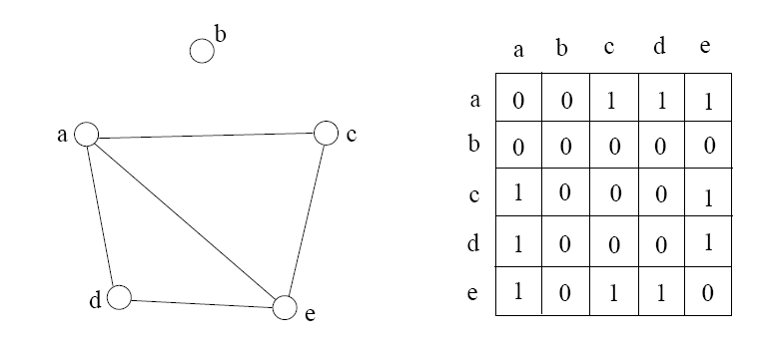
Adjacency Matrix
2D array A[0..n-1, 0..n-1], where n is the number of vertices in the graph
Each row and column is indexed by the vertex id
  e,g a=0, b=1, c=2, d=3, e=4
A[i][j]=1 if there is an edge connecting vertices i and j; otherwise, A[i][j]=0

Slide 12
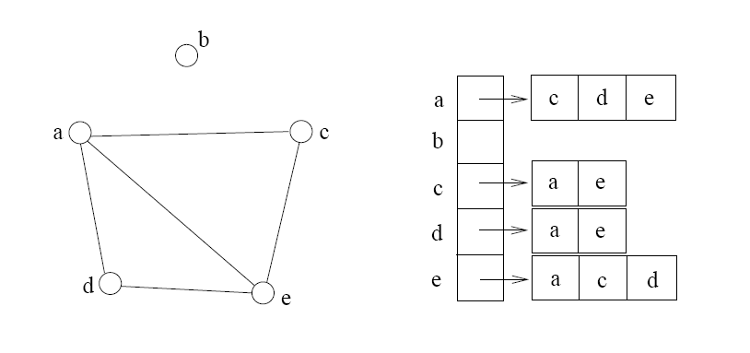
Adjacency List
If the graph is not dense, in other words, sparse, a better solution is an adjacency list
The adjacency list is an array A[0..n-1] of lists, where n is the number of vertices in the graph.
Each array entry is indexed by the vertex id
Each list A[i] stores the ids of the vertices adjacent to vertex i

Slide 13
Which Representation Is Better?
The adjacency-list is usually preferred if the graph is sparse (having few edges).
The adjacency-matrix is preferred if the graph is dense (the number of edges is close to the maximal number of edges).
Dense Graph
Sparse Graph
Figure: Dense and Sparse Graph

Slide 14
END!!!

